Slide 1
DATALOGGER USER MANUAL
BY: ANTHONY e. rATERTA

Slide 2
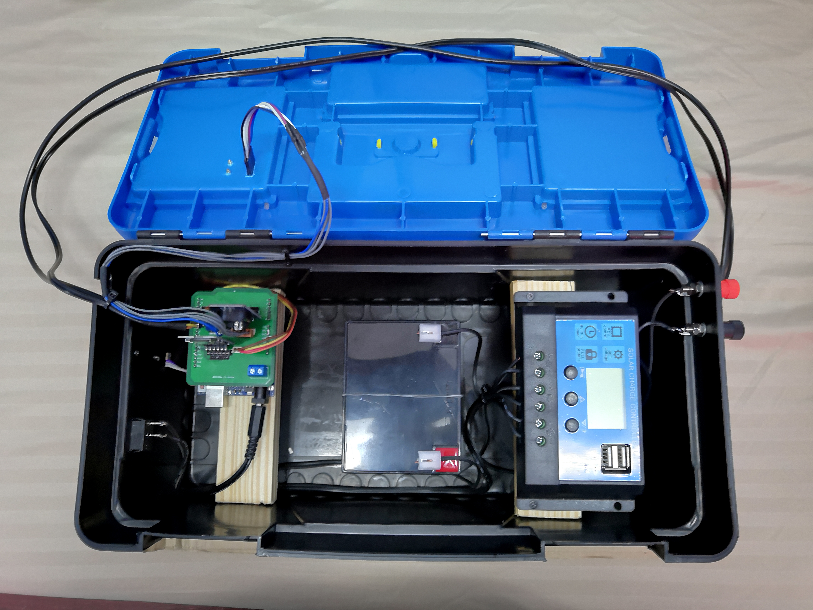
8
1
4
2
7
5
6
3

Slide 3
I. Parts List
1. Soil Moisture and Soil Temperature Probes
2. Solar Panel Jacks ( Red = Positive, Black = Negative)
3. Solar Charge Controller
4. 12 Volts Lead Acid Battery
5. Arduin UNO with device PCB (Printed Circuit Board)
6. Device Switch
7. DHT22 Module (Air Temperature and Humidity)
8. BH1750 (Light Intensity Sensor)

Slide 4
Soil Moisture and Soil Temperature Probes
Depending on the sampling specifications, the depth of the probes varies. Take note that the length of the wires in the probes from the device is approximately 1meter. Avoid pulling the probes hard from the device for it could cause breakage in the connection making it unable to perform its prescribed duties.

Slide 5
Solar Panel Jacks
The Solar Panel was designed to be detachable from the device to provide ease during transport into the sampling site. Take note the polarities upon attaching the solar panel into the device as well as not to short them for it could damage the charge controller.
RED = Positive
BLACK = Negative

Slide 6
Solar Charge Controller
The Solar Charge Controller’s job is to facilitate the charging of the battery using a solar panel as a charging unit. Shown default in the charge controller is the voltage level of the battery as well as the indicators whether a solar panel, a battery or a load is attached into it.

Slide 7
12 Volts Lead Acid Battery
The Lead Acid Battery is the primary source to charge up the Arduino continuously based on the prescribed duration of sampling. It must be kept dry to avoid shorting and further damage in the device

Slide 8
Arduin UNO with device PCB
The Arduino UNO serves as the control unit of the device which manipulates, gathers the necessary sampling data and writes it into the micro SD Card attached in the PCB fabricated. To avoid malfunctions, as much as possible, minimize shakings and mishandling of the device.

Slide 9
DHT22 Module
The DHT 22 Module is capable of determining the Air Temperature and Humidity of the environment it is exposed. Make sure to have the module kept dry most of the time.

Slide 10
DHT22 Module
The DHT 22 Module is capable of determining the Air Temperature and Humidity of the environment it is exposed. Make sure to have the module kept dry most of the time.

Slide 11
BH1750 (Light Intensity Sensor)
The BH1750 sensor gathers the light intensity of the environment it is exposed. It is located at the top of the device to maximize receiving light input.

Slide 12
II. Device Sampling Procedure
1. Pick the desired sampling spot.
2. Attach the soil temperature and soil moisture probes into the soil.
3. Attach the solar panel into the jacks
4. Turn on the device switch

Slide 13
III. Debugging and Connectivity Checking
Alternatively, you can connect the device into a laptop/computer which also serve as a secondary power source.
WARNING: Make sure to have the device switch turned-off for the cannot work with two (2) power source attached simultaneously.

Slide 14
Arduino IDE and Libraries Installation

